Slide 1
Individual in Society
Our 8th Grade theme

Slide 2
INDIVIDUAL

Slide 3
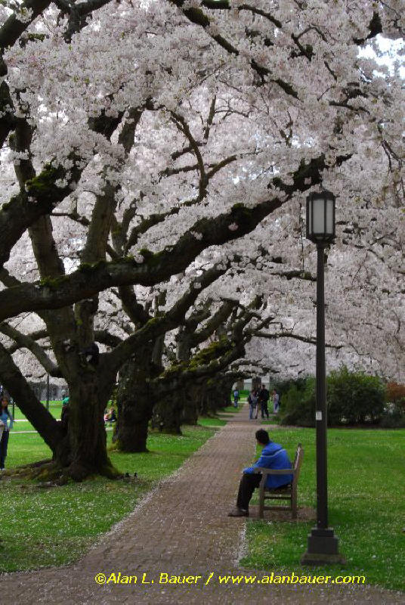

Slide 4
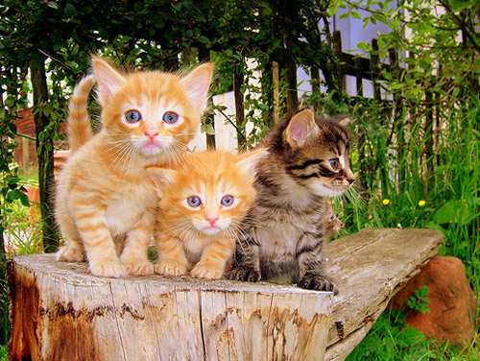

Slide 5
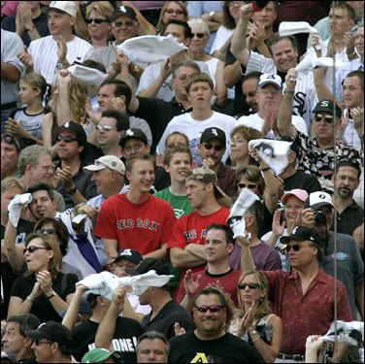

Slide 6
SOCIETY

Slide 7
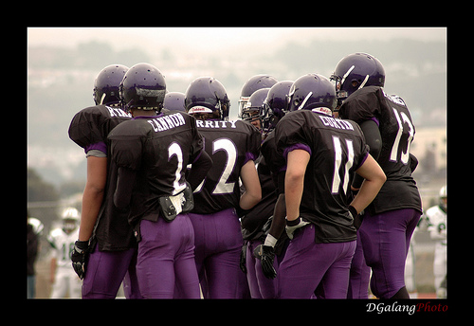

Slide 9
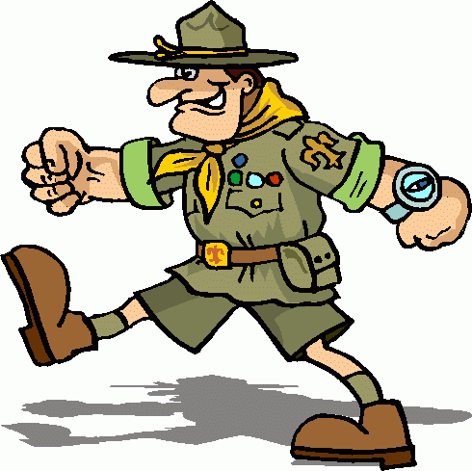

Slide 10
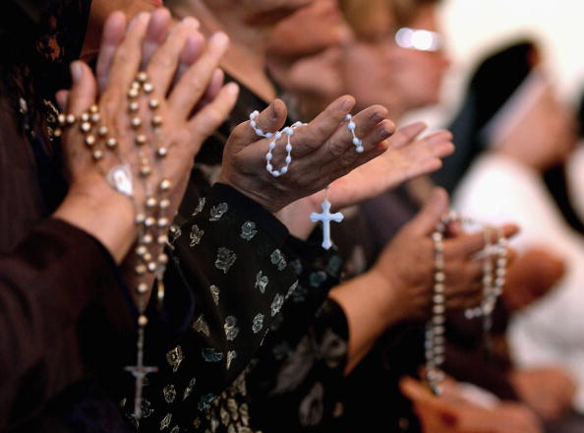

Slide 11
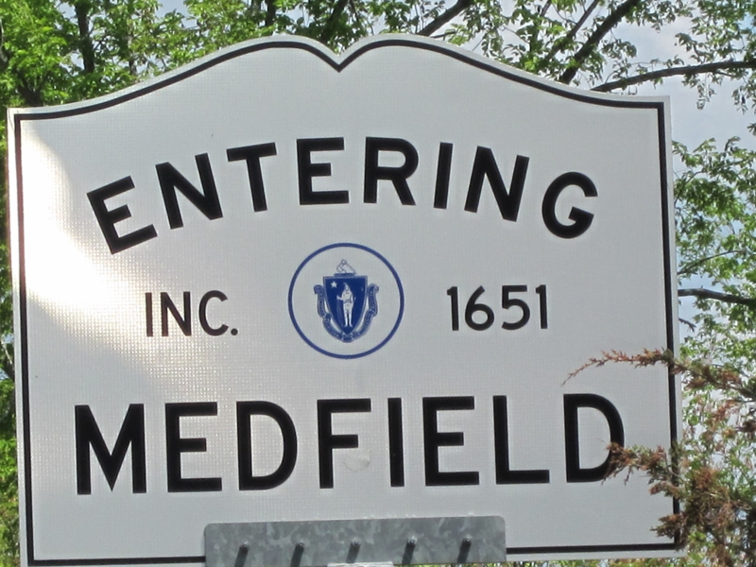

Slide 12
COMMUNITY

