Slide 1
SYMBOLS
What are they?

Slide 2
Something that stands for something else

Slide 3
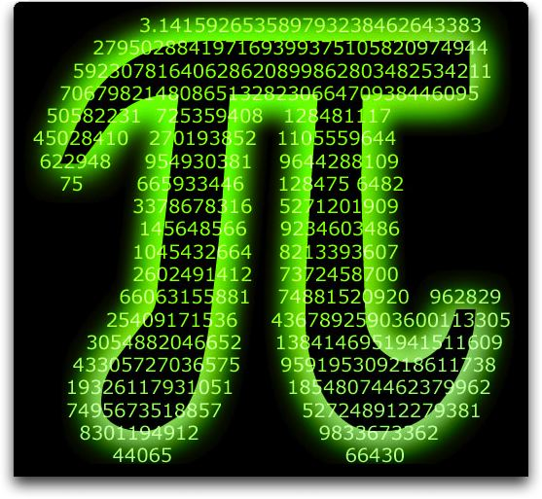

Slide 4
Something concrete that represents or suggests another thing that cannot be pictured

Slide 6
a letter, character, or sign

Slide 8
What do the following symbolize?

